Slide 1
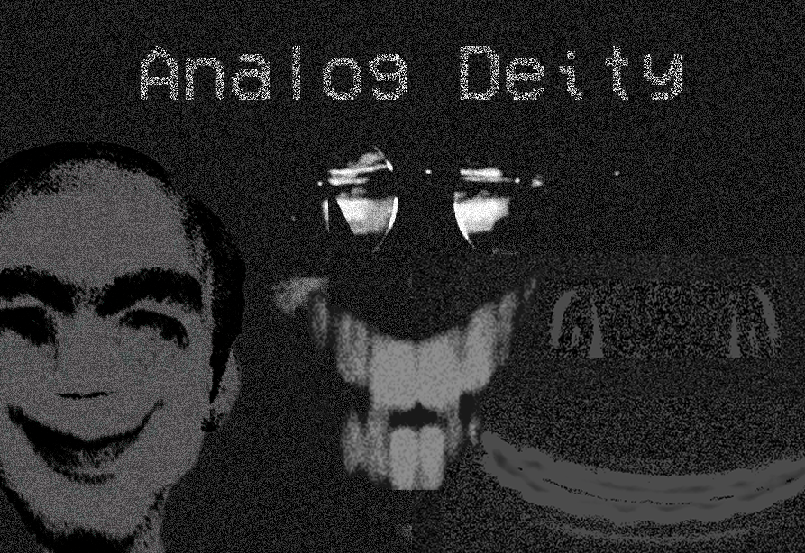
Analog Deity
Team 1 - Mac, Kamau, Hassan, Tej

Slide 2
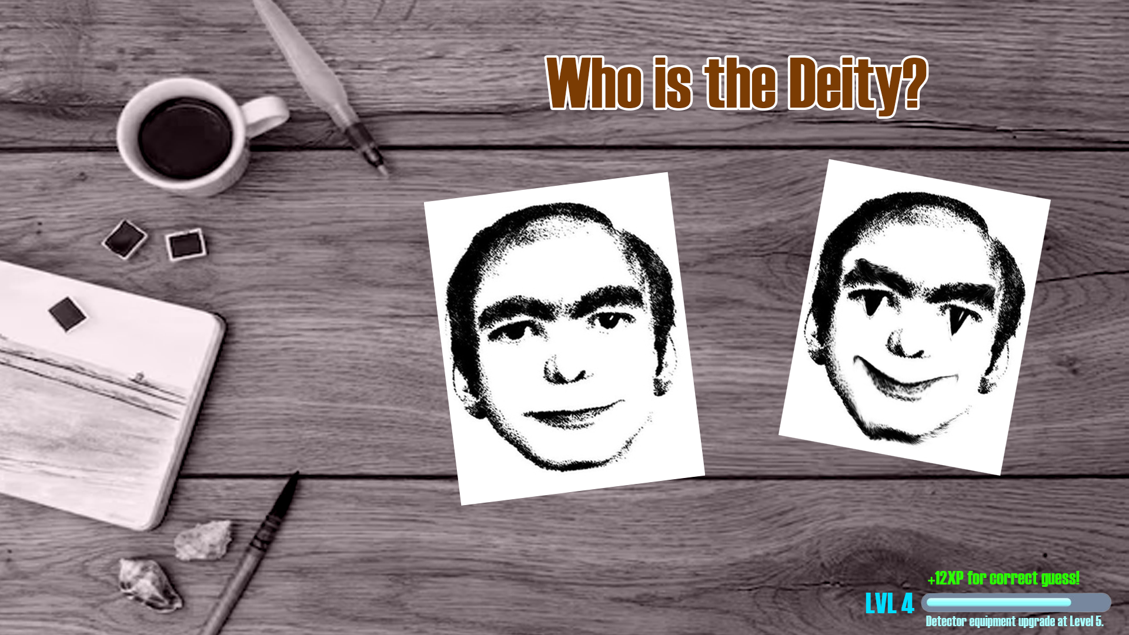
ELEVATOR PITCH
Compare images of people/scenes and deduce which one is a real and which one is a ‘deity’.
Concept art

Slide 3
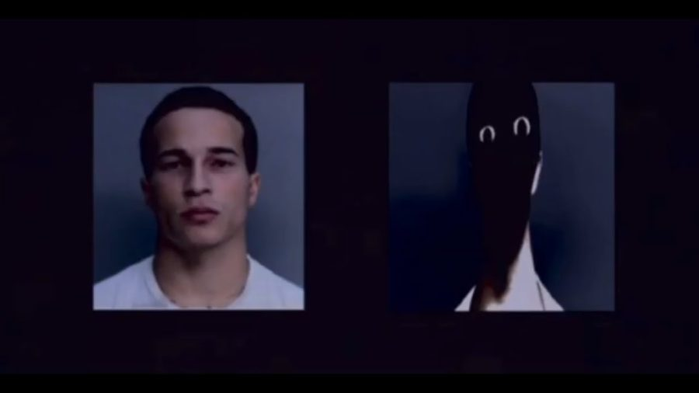
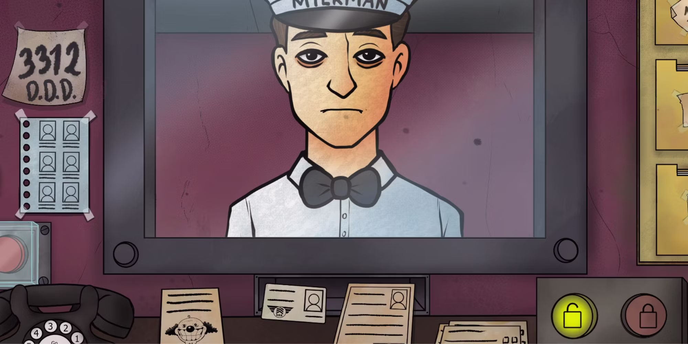
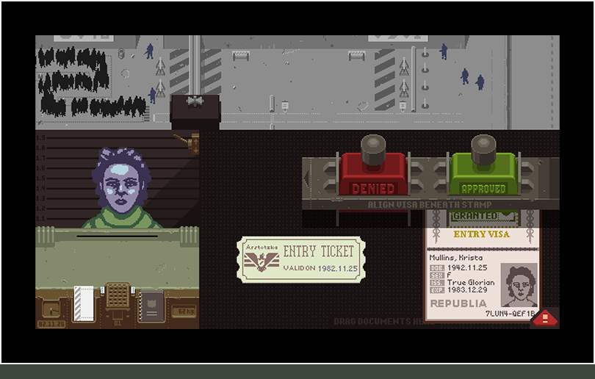
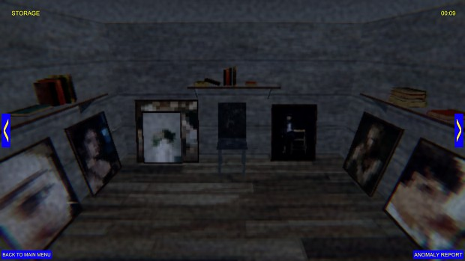
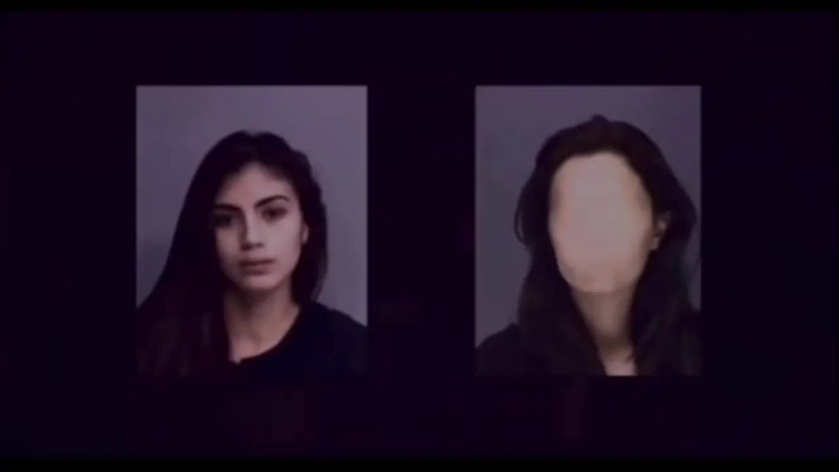
CONCEPTS/INSPIRATION
The images below consist of various games, videos and internet horror which we’re using
as concepts and inspirations for Analog Deity.
Papers, Please (2013)
That's not my neighbour
(2024)
Mandela Catalogue
(2021)

Slide 4
GAMEPLAY AND GAME LOOPS
Overall game aims and objectives
Observe the deities, locate anomalies.
Game loops, how do you play the game?
Select between images
One of the images will be the original and one will be a modified ‘alternate’ version.
What are the rewards and how do you win?
XP for correct guesses that can be used to upgrade investigation equipment.

Slide 5
PLAYER EXPERIENCE
How many levels?
Analog Deity will consist of one main level (consisting of the workspace) with a large variety of assets. Each time the level is replayed, the assets are different.
How long will each level take?
On average, a level will take around 2-3 minutes to complete (levels can be completed quicker with in-game tools which aid the player such as the Magnifying Glass).
What will player be willing to pay for?
In-Game currency which will allow for improved analysis tools (Magnifying Glass, Flashlight, etc).
XP Boosters which will allow faster Player Level gain (certain tools are only available at a certain level and can’t be bought via in-game currency.
Extra lives for too many incorrect guesses can be purchased.

Slide 6
VIDEO TRAILER
https://youtu.be/Dc4X5qgF4O4

Slide 7
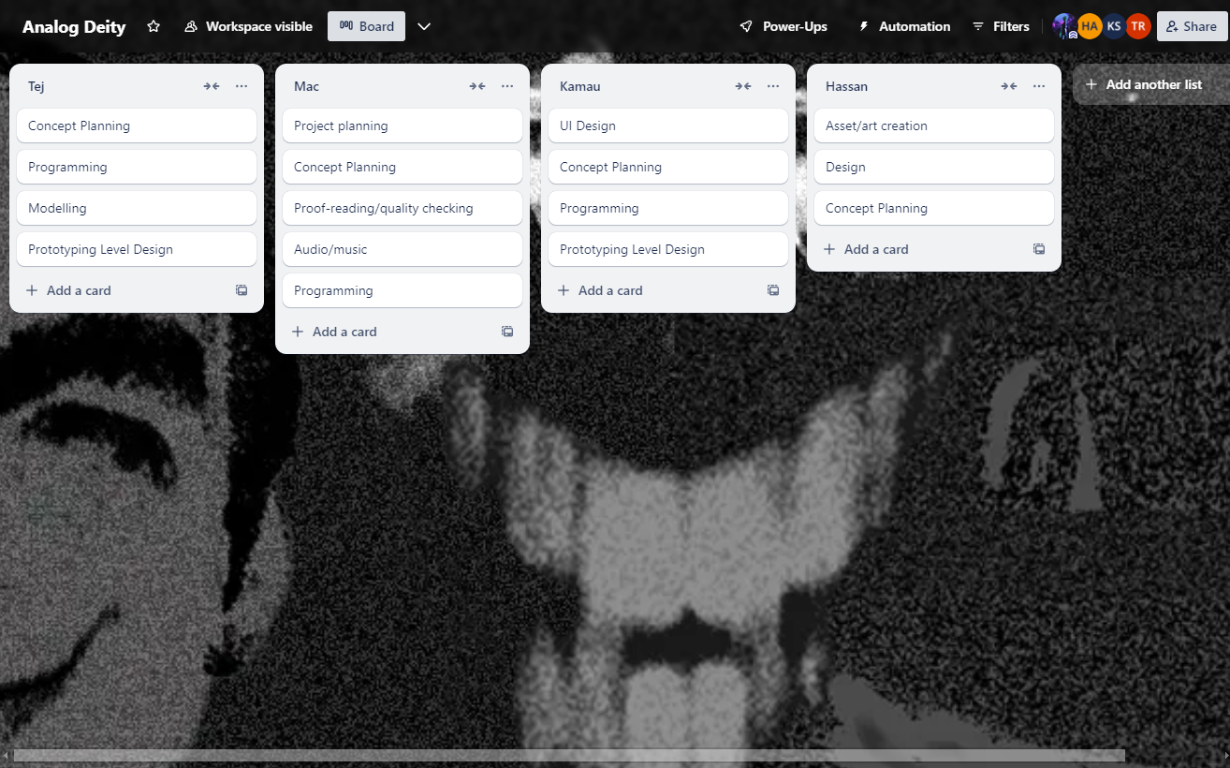
AGILE SPRINTS PLAN
https://trello.com/b/YNHiOwcy

